Slide 1

Project Presentation 2 ME 609 – Optimisation Methods in Engineering
Multivariable Method: Conjugate Direction Method
Unidirectional Search: Bounding Phase & Newton Raphson
Group No : 7
Nirmal S. [234103107]
Rohith Kumar Saragadam [234103109]

Slide 2
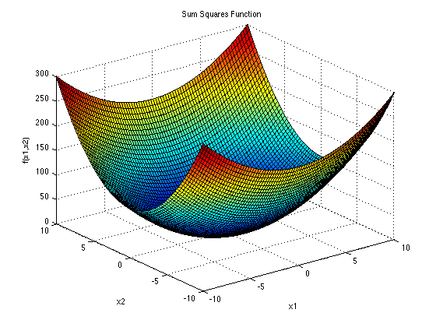
Sum Squares Function
Optimal Solution: $x^{∗}=\left(0, 0, 0, 0, 0\right); f\left(x^{∗}\right)=0$
Trial | Initial Point (x0) | Final Point (x*) | Function Value f(x*) | No. of Fn. Eval
1 | (5.000, 5.000, 5.000, 4.000, 3.000) | (-0.000, 0.000, 0.000, 0.000, -0.000) | 0 | 203
2 | (1.000, 3.000, 2.450, 2.345, 3.345) | (0.000, 0.000, 0.000, 0.000, -0.000) | 0 | 200
3 | (-1.000, -3.000, -2.450, -2.345, -3.345) | (-0.000, -0.000, -0.000, -0.000, 0.000) | 0 | 193
4 | (5.000, 5.000, 5.000, 5.000, 5.000) | (0.000, -0.000, -0.000, -0.000, 0.000) | 0 | 209
5 | (5.000, -5.000, 5.000, -5.000, 5.000) | (0.000, 0.000, -0.000, 0.000, 0.000) | 0 | 209
6 | (-5.000, -5.000, -5.000, -5.000, -5.000) | (-0.000, 0.000, 0.000, 0.000, -0.000) | 0 | 202
No. | Point (x) | Fn_val f(x)
0 | (5.000, 5.000, 5.000, 4.000, 3.000) | 259
1 | (-0.000, 5.000, 5.000, 4.000, 3.000) | 234
2 | (-0.000, 0.000, 5.000, 4.000, 3.000) | 184
3 | (-0.000, 0.000, -0.000, 4.000, 3.000) | 109
4 | (-0.000, 0.000, -0.000, -0.000, 3.000) | 45
5 | (-0.000, 0.000, -0.000, -0.000, -0.000) | 0
6 | (-0.000, 0.000, -0.000, -0.000, -0.000) | 0
7 | (-0.000, 0.000, -0.000, 0.000, -0.000) | 0
8 | (-0.000, 0.000, -0.000, 0.000, -0.000) | 0
9 | (-0.000, 0.000, -0.000, 0.000, -0.000) | 0
10 | (-0.000, 0.000, -0.000, 0.000, -0.000) | 0
11 | (-0.000, 0.000, -0.000, -0.000, -0.000) | 0
12 | (-0.000, 0.000, 0.000, 0.000, -0.000) | 0
Observation:
The point seem to tend toward the Global Minima with any initial value.
The number of function evaluation seem to be about the same for any initial point.

Slide 3
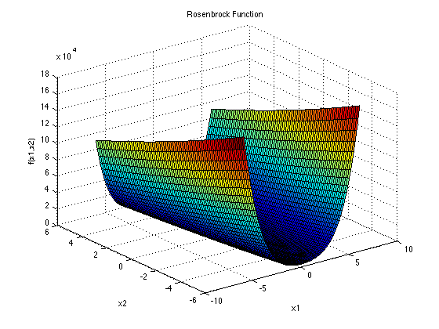
Rosenbrock Function
Optimal Solution: $x^{∗}=\left(1, 1, 1\right); f\left(x^{∗}\right)=0$
Trial | Initial Point (x0) | Final Point (x*) | Function Value f(x*) | No. of Fn. Eval
1 | (-2.000, 0.000, 2.000) | (0.976, 0.949, 0.901) | 0.005 | 2128
2 | (-1.000, 1.000, 0.000) | (-0.758, 0.585, 0.346) | 3.276 | 234
3 | (1.020, 1.050, 0.980) | (1.001, 1.002, 1.004) | 0.000 | 193
4 | (1.500, 1.500, 0.500) | (0.953, 0.909, 0.825) | 0.011 | 228
5 | (-0.700, 0.500, 0.300) | (-0.092, -0.005, 0.009) | 2.232 | 2770
6 | (-0.800, 0.600, 0.100) | (-0.372, 0.121, 0.024) | 2.697 | 2478
7 | (-2.000, 0.600, 2.000) | (1.106, 1.224, 1.499) | 0.062 | 312
8 | (-2.000, -2.000, -2.000) | (0.954, 0.908, 0.819) | 0.014 | 1593
9 | (-2.000, -2.000, 1.000) | (0.392, 0.136, -0.016) | 1.268 | 631
10 | (-2.000, 1.000, 1.000) | (-1.127, 1.280, 1.644) | 4.616 | 388
11 | (1.000, 1.000, 1.000) | (1.000, 1.000, 1.000) | 0.000 | 59
No. | Point (x) | Fn_val f(x)
0 | (-2.000, 0.600, 2.000) | 1434.120
1 | (-0.008, 0.600, 2.000) | 306.128
2 | (-0.008, 1.224, 2.000) | 176.050
3 | (-0.008, 1.224, 1.499) | 150.961
4 | (1.106, 1.224, 1.499) | 0.062
5 | (1.106, 1.224, 1.499) | 0.062
6 | (1.106, 1.224, 1.499) | 0.062
7 | (1.106, 1.224, 1.499) | 0.062
8 | (1.106, 1.224, 1.499) | 0.062
Observation:
There seem to be multiple points at which the conjugate method converges.
When the initial point is near the Global Minima, it converges near it.

Slide 4
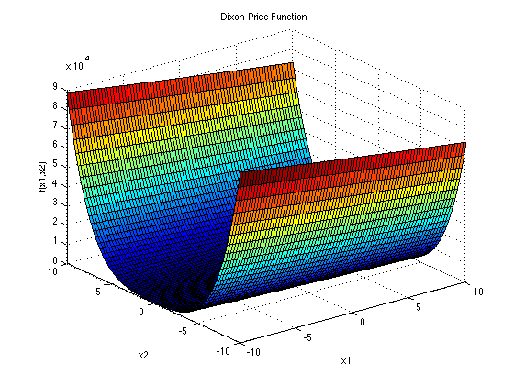
Dixon-Price Function
Optimal Solution: $x^{∗}=\left(1.0, 0.707, 0.594, 0.545\right); f\left(x^{∗}\right)=0$
Trial | Initial Point (x0) | Final Point (x*) | Function Value f(x*) | No. of Fn. Eval
1 | (1.000, 0.700, 0.600, 0.500) | (1.004, 0.708, 0.596, 0.546) | 0 | 2282
2 | (3.000, 7.000, 6.000, 5.000) | (-253.848, -0.256, 1.114, -0.733) | 193980.9 | 586
3 | (0.000, 0.000, 0.000, 0.000) | (0.778, 0.000, 0.000, 0.001) | 1.259 | 72
4 | (1.000, 1.000, 1.000, 1.000) | (0.228, -0.541, -0.104, -0.195) | 1.935 | 4885
5 | (0.980, 0.650, 0.550, 0.450) | (0.128, -0.591, 0.055, -0.048) | 2.492 | 2081
6 | (-1.000, -0.700, 0.000, -0.500) | (-7.787, 0.176, -0.505, -0.009) | 201.754 | 830
7 | (1.000, 0.700, 0.600, -0.500) | (-9.848, -0.202, 0.286, 0.973) | 325.62 | 2109
No. | Point (x) | Fn_val f(x)
0 | (1.000, 0.700, 0.600, 0.500) | 0.042
1 | (1.013, 0.700, 0.600, 0.500) | 0.0436
2 | (1.013, 0.707, 0.600, 0.500) | 0.0411
3 | (1.013, 0.707, 0.614, 0.500) | 0.059
4 | (1.013, 0.707, 0.614, 0.554) | 0.0072
5 | (1.018, 0.707, 0.614, 0.554) | 0.0076
6 | (1.018, 0.706, 0.613, 0.551) | 0.0074
7 | (1.025, 0.706, 0.613, 0.551) | 0.0084
8 | (1.025, 0.707, 0.613, 0.551) | 0.0078
9 | (1.025, 0.707, 0.599, 0.551) | 0.0024
10 | (1.025, 0.707, 0.599, 0.548) | 0.0022
30 | (1.007, 0.709, 0.596, 0.546) | 0.0001
31 | (1.006, 0.709, 0.596, 0.546) | 0
32 | (1.005, 0.709, 0.596, 0.546) | 0
33 | (1.005, 0.709, 0.596, 0.546) | 0
34 | (1.005, 0.708, 0.596, 0.546) | 0
35 | (1.005, 0.708, 0.596, 0.546) | 0
36 | (1.004, 0.708, 0.596, 0.546) | 0
37 | (1.004, 0.708, 0.596, 0.546) | 0
38 | (1.004, 0.708, 0.596, 0.546) | 0
39 | (1.004, 0.708, 0.596, 0.546) | 0
40 | (1.004, 0.708, 0.596, 0.546) | 0
Observation:
There seem to be multiple points at which the conjugate method converges.
When the initial point is near the Global Minima, it converges near it.

Slide 5
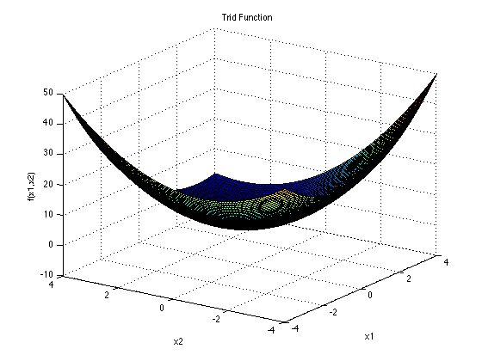
Trid Function
Optimal Solution: $x^{∗}=\left(6, 10, 12, 12, 10, 6\right); f\left(x^{∗}\right)=−50$
Trial | Initial Point (x0) | Final Point (x*) | Function Value f(x*) | No. of Fn. Eval
1 | (6.000, 10.000, 12.000, 12.000, 10.000, 6.000) | (6.000, 10.000, 12.000, 12.000, 10.000, 6.000) | -50 | 79
2 | (5.000, 9.000, 10.000, 9.000, 9.000, 3.000) | (5.959, 9.816, 11.675, 11.256, 8.992, 5.772) | -49.526 | 1381
3 | (-5.000, -9.000, -10.000, -9.000, -9.000, -3.000) | (5.936, 9.910, 11.878, 11.854, 9.761, 5.022) | -49.242 | 1741
4 | (0.000, -10.000, 4.000, 6.000, 10.000, -12.000) | (3.590, 5.373, 5.095, 4.714, 4.313, 2.842) | -32.509 | 2347
5 | (1.000, -1.000, 1.000, 1.000, 1.000, -1.000) | (6.036, 10.055, 12.065, 11.961, 9.977, 6.060) | -49.988 | 3036
6 | (-1.000, -1.000, -1.000, -1.000, -1.000, -1.000) | (5.998, 9.998, 11.998, 11.998, 9.998, 5.997) | -50 | 1138
7 | (0.000, 0.000, 0.000, 0.000, 0.000, 0.000) | (6.001, 10.001, 12.002, 12.001, 10.002, 6.002) | -50 | 1117
8 | (12.000, 12.000, 12.000, 12.000, 12.000, 12.000) | (6.646, 11.260, 13.832, 14.074, 11.800, 7.117) | -48.515 | 2306
9 | (15.000, 15.000, 15.000, 15.000, 15.000, 15.000) | (7.269, 12.548, 14.994, 14.541, 11.609, 6.674) | -47.076 | 1277
10 | (1.000, 1.000, 1.000, 1.000, 1.000, 1.000) | (5.986, 9.971, 11.933, 11.818, 9.349, 6.393) | -49.26 | 1012
No. | Point (x) | Fn_val f(x)
0 | (5.000, 9.000, 10.000, 9.000, 9.000, 3.000) | -40
1 | (5.500, 9.000, 10.000, 9.000, 9.000, 3.000) | -40.25
2 | (5.500, 8.750, 10.000, 9.000, 9.000, 3.000) | -40.3125
3 | (5.500, 8.750, 9.875, 9.000, 9.000, 3.000) | -40.3281
4 | (5.500, 8.750, 9.875, 10.437, 9.000, 3.000) | -42.3945
5 | (5.500, 8.750, 9.875, 10.437, 7.719, 3.000) | -44.0361
78 | (5.959, 9.816, 11.675, 11.257, 8.992, 5.772) | -49.526
79 | (5.959, 9.816, 11.675, 11.257, 8.992, 5.772) | -49.526
80 | (5.960, 9.816, 11.675, 11.257, 8.992, 5.772) | -49.526
81 | (5.960, 9.816, 11.675, 11.257, 8.992, 5.772) | -49.526
82 | (5.959, 9.816, 11.675, 11.256, 8.992, 5.772) | -49.526
83 | (5.959, 9.816, 11.675, 11.256, 8.992, 5.772) | -49.526
84 | (5.959, 9.816, 11.675, 11.256, 8.992, 5.772) | -49.526
Observation:
The point seem to tend toward the Global Minima with almost any initial value.

Slide 6
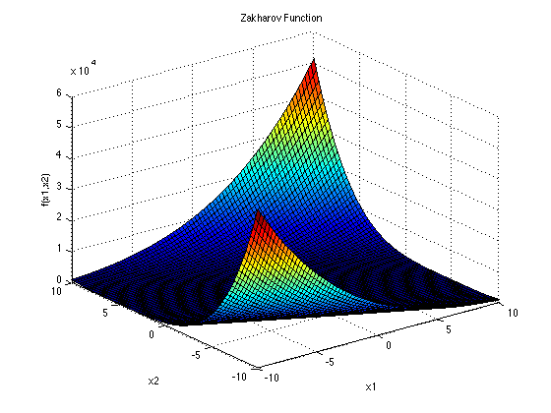
Zakharov Function
Optimal Solution: $x^{∗}=\left(0, 0\right); f\left(x^{∗}\right)=0$
Trial | Initial Point (x0) | Final Point (x*) | Function Value f(x*) | No. of Fn. Eval
1 | (0.000, 0.000) | (-0.000, 0.000) | 0 | 33
2 | (1.000, -2.000) | (0.000, 0.000) | 0 | 357
3 | (5.000, -2.000) | (0.000, 0.000) | 0 | 359
4 | (5.000, -10.000) | (0.000, -0.000) | 0 | 336
5 | (-15.000, -10.000) | (0.000, -0.000) | 0 | 339
No. | Point (x) | Fn_val f(x)
0 | (5.000, -2.000) | 29.3125
1 | (1.827, -2.000) | 9.9119
2 | (1.827, -0.518) | 3.7855
3 | (0.255, -0.518) | 0.5097
4 | (-0.188, -0.101) | 0.0848
5 | (0.041, -0.101) | 0.0183
6 | (-0.041, -0.023) | 0.0042
7 | (0.001, -0.001) | 0
8 | (-0.000, -0.000) | 0
9 | (0.000, -0.000) | 0
10 | (0.000, 0.000) | 0
11 | (0.000, 0.000) | 0
12 | (0.000, 0.000) | 0
Observation:
The point seem to tend toward the Global Minima with any initial value.

Slide 7
Thank you

